Slide 1
Install and operate in VM mode
API Management

Slide 2
Understand any roles of the API Management components on a Virtual Machine
Understand tools provided by Axway to operate the solution
Discover the policy studio
Follow 3 labs :
Install all components in unattended mode (excepted for the policy studio)
Use the policy studio to setting up manually the API Management, Discover the UI.
Apply Security patchs
What about security patch ?
Notes:
Welcome to this elearning session about Amplify API mangement V7.
This

Slide 3
Prerequisites
Install or upgrade in VM mode

Slide 4
Before You Begin
Be familiar with these concepts:
Basic of API Management
Cassandra instance in v3.11 (Module 35)
You will need to follow the lab:
A VM on Centos 8 ou RHEL to install the gateway. (Or reuse the Cassandra VM)
A web Browser up to date.
A client desktop
An internet access to install Mysql and additional libraries.
Notes:
VM : 8Gb memory and 2 vcpu
Client desktop :
X-windows for Linux
Windows 7 to 10.

Slide 5
A VM on CentOs 8 ou RHEL
A web Browser up to date.
A graphical client environment for the policy studio
An internet access to install Mysql and additional library.
The APIM package 7.7 release 20210530
The client tools only for windows
https://support.axway.com/en/downloads/download-details/id/1449331
https://support.axway.com/en/downloads/download-details/id/1448549
Notes:
A VM on CentOs 8 ou RHEL to install the gateway. (Or reuse the Cassandra VM)
VM : 8Gb memory and 2 vcpu
Client desktop :
X-windows for Linux
Windows 7 to 10.

Slide 6
Install/upgrade APIM
Components overviews

Slide 7
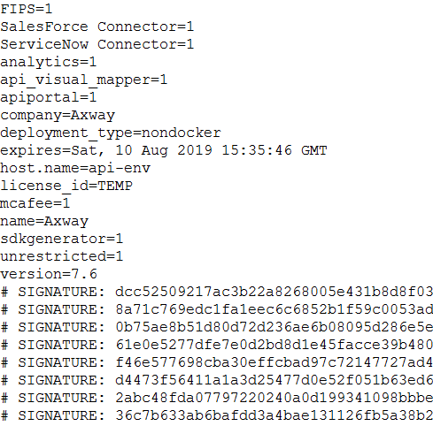
License
The solution require a license key to start
This license contains component, expiration date, and kind of deployment

Slide 8
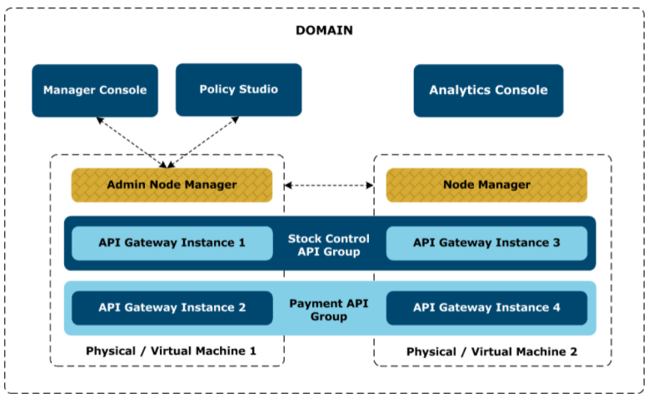
API Gateway groups and domains
https://docs.axway.com/bundle/axway-open-docs/page/docs/api_mgmt_overview/key_concepts/apigtw_groups_and_domains/index.html

Slide 9
Global overview
This course is referring to a simple installation. So One domain and one default group.
8075 : UI
8065: Traffic
8080 : default Listener
8085: admin (anm com
8090: 9040
8090: UI +API
Analytics
API Gateway Manager
API-Manager
API-Gateway instance
9042: listener
Mysql
Cassandra

Slide 10
A persona per components
Admin node manager:
Administrator of the solution
API project manager
API Gateway / api-manager : consumers
API Analytics
Notes:
Describe all persons

Slide 11
Admin Node Manager

Slide 12
API Manager

Slide 13
API Gateway

Slide 14
Analytics

Slide 17
Install/upgrade APIM
Install APIM

Slide 18
2 ways to install :
Graphical mode
Unattended
Here is a list of tools that we will use:
Managed domain
Start/stop
Notes:
This topic will follow the unattended way, also for first deployment.

Slide 19
Install/upgrade APIM
Install APIM

Slide 20
To show:
Install prerequisite libraries
Install Mysql database
Download the APIM package
Install Admin node manager
Install API Gateway instance
Install analytics
Notes:
Configure :
ENV LANG=en_US.UTF-8
sudo yum install libnsl glibc-langpack-en

Slide 21
Install/upgrade APIM
Basic Operations

Slide 22
Start/stop/status of instances
From the UI
Fin Command line
API Gateway instance :
Executable
apigateway/posix/bin/startinstance
Start
startinstance -n "QuickStart Server" -g "QuickStart Group" -d
Stop
startinstance -n "QuickStart Server" -g "QuickStart Group" -k
Status
ps -eaf | grep -i " "QuickStart Server"
netstat -an | grep 8080

Slide 23
Install/upgrade APIM
Basic Operations

Slide 24
Configure the prerequisites
Notes:
Configure :
ENV LANG=en_US.UTF-8
sudo yum install libnsl glibc-langpack-en

Slide 25
Install/upgrade APIM
Upgrade APIM

Slide 26
Describe how to upgrade the package.

Slide 27
Install/upgrade APIM
Upgrade APIM

Slide 28
To show:
Configure the prerequisites
Install new version
Upgrade the FED file
Restart to the new version
Notes:
Configure :
ENV LANG=en_US.UTF-8
sudo yum install libnsl glibc-langpack-en

Slide 29

Prerequisites
Key Question: What are the rules of the Knowledge Check?
To be addressed by SME and CA
For each (or all of) the questions:
How many attempts per question (between 1 and Infinite)?
Result of the Quiz:
Validation of the quiz through a score or only by doing it?
What is the % of good answer for validating the entire quiz if needed ?
Do we allow the learner to review the Quiz ?
If he review does the learner see only where he failed or do we show him the good answers ?

